Slide 1

Siamese Neural Network
Effect of the architecture and hyperparameters on the performance of an Iris recognition Siamese Neural Network
The experiment and the presentation were done by:
Zahir Bilal

Slide 2
CONTENT
Introduction
Objectives
Datasets
Experiment
Results
Improvements

Slide 3
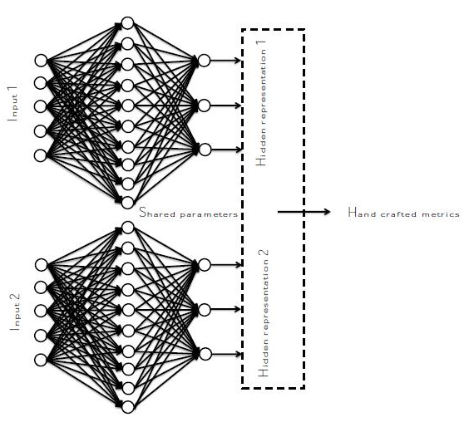
Introduction
Siamese Neural Network (scheme & advantage)
One-shot multiple way learning
Identical Networks with identical parameters (weights, biases etc.)
Traditional deep learning approaches: require a large datasets for the training of the model
One-shot or multiple-shot learning approach: When small datasets available

Slide 4
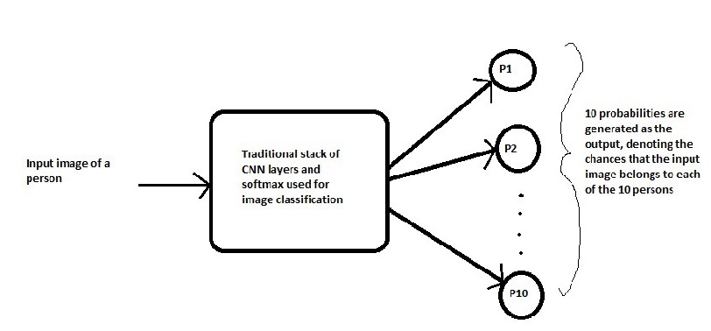
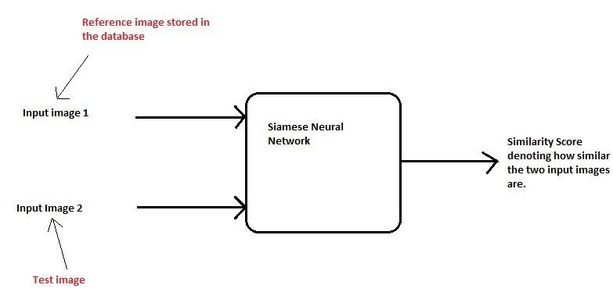
Introduction
Classification Vs Similarity

Slide 5
Objectives
Investigate the effect of changing the architecture of the Siamese neural network (CNN, MLP)
Investigate the effect of changing the structure of each used neural network (no. of layers, size of the filters, size of the FC layer etc.)
Evaluate the performance of the different structures of Siamese neural networks on different data sets
Evaluate the importance of using Batch normalization and generalization techniques

Slide 6
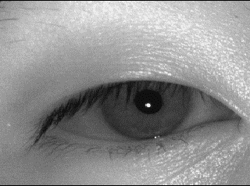
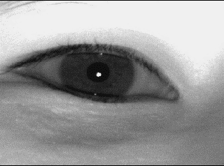
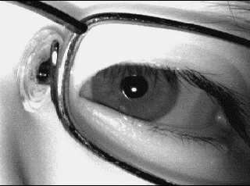
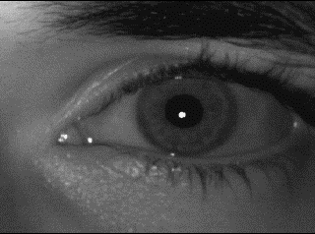
Datasets
MMU 2: Used for training and testing
Multimedia University (MMU2) database is a public database consisting of Eye Images for training models of IRIS based Biometric attendance system. IRIS patterns for each Eye are unique for every individual. This Dataset consist of both 5 images each of left and right IRIS of 100 persons.
Challenge: Noise-Factors resulted from the existence of eye-lashes, glasses etc.

Slide 7
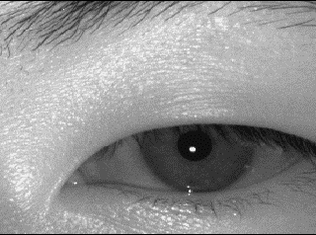
Datasets
Similar
Unsimilar

Slide 8
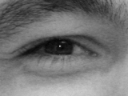
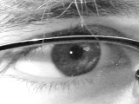
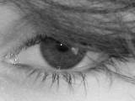
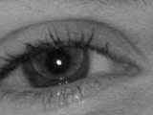
Datasets
UBIRIS.v2 : Used for testing the trained models
“The second version of the UBIRIS database has over 11 000 images (and continuously growing) and more realistic noise factors.
Images were actually captured at-a-distance and on-the-move.”
http://iris.di.ubi.pt/

Slide 9
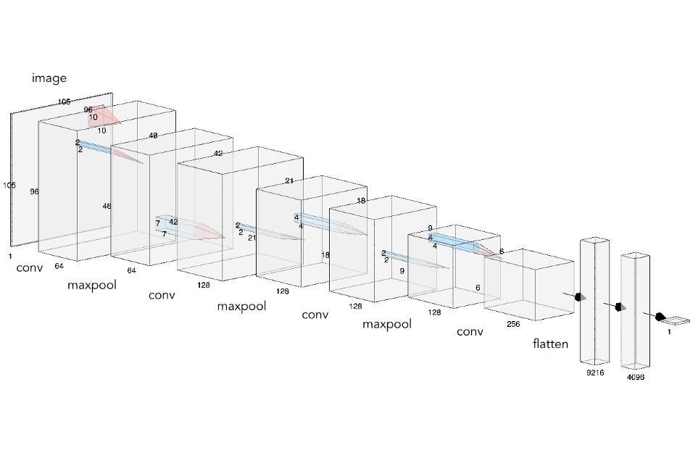
Experiment - Network
A Convolutional Neural network as the one in the paper: Siamese Neural Networks for One-shot Image Recognition, Koch et al.
Were utilized, with variations.

Slide 10
Experiment - Network
Convolutional Neural Network
VGG-16 (Modified)
(conv11): Conv2d(1, 64, kernel_size=(3, 3), stride=(1, 1))
(conv12): Conv2d(64, 64, kernel_size=(3, 3), stride=(1, 1))
(conv21): Conv2d(64, 128, kernel_size=(3, 3), stride=(1, 1))
(conv22): Conv2d(128, 128, kernel_size=(3, 3), stride=(1, 1))
(conv31): Conv2d(128, 256, kernel_size=(3, 3), stride=(1, 1))
(conv32): Conv2d(256, 256, kernel_size=(3, 3), stride=(1, 1))
(conv33): Conv2d(256, 256, kernel_size=(3, 3), stride=(1, 1))
(pool): MaxPool2d(kernel_size=2, stride=2, padding=0, dilation=1, ceil_mode=False)
(fc1): Linear(in_features=16384, out_features=4096, bias=True)
(fc2): Linear(in_features=4096, out_features=4096, bias=True)
(fcOut): Linear(in_features=4096, out_features=1, bias=True)
(sigmoid): Sigmoid()

Slide 11
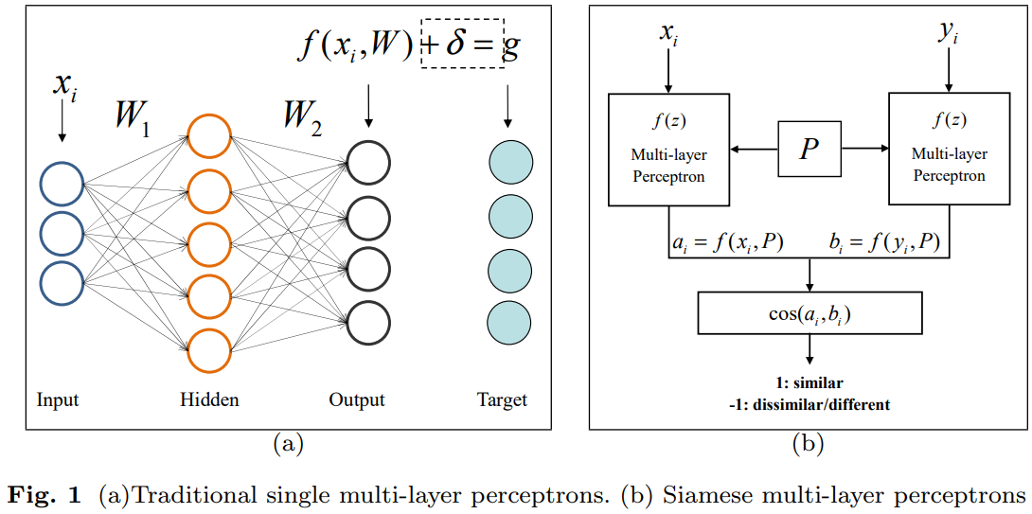
Experiment - Network
Multi-Layer Perceptron neural network
Were used
With different variations
Lilei Zheng, Stefan Duffner, Khalid Idrissi, Christophe Garcia, Atilla Baskurt. Siamese Multi-layer Perceptrons for Dimensionality Reduction and Face Identification. Multimedia Tools and Applications, Springer Verlag, 2015, pp.,. ff10.1007/s11042-015-2847-3ff. ffhal-01182273f

Slide 12
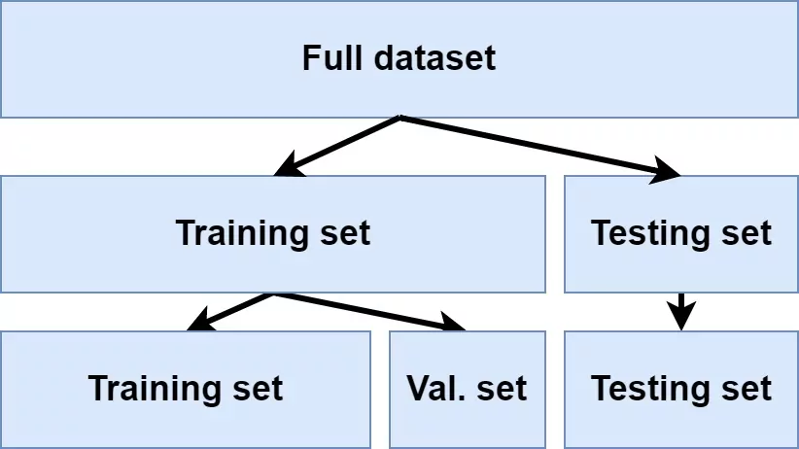
Experiment
Dataset
60 % training
20 % validation
20 % testing

Slide 13
Experiment - Training
Randomly select a pair of images to train
if: Two Images from same subject (person)
Then: similarity = 1
If: Two Images from different subject (person)
Then: similarity = 0
Selection of images is ensured to be balanced, i.e., the network is trained on 50 % similar images and 50 unsimilar images
Same image transformation
Size of training pairs used: 10000 images
Optimizer: Adam
Loss Criterion: Binary Cross Entropy
Learning rate: different values tried, best results (0.0005 – 0.001)

Slide 14
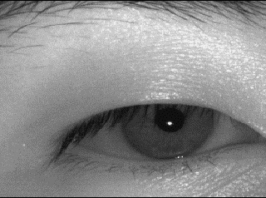
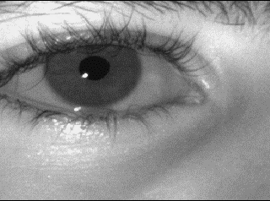
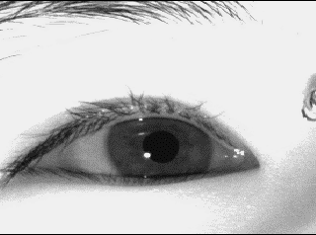
Experiment - Training
Training Sample
Training Sample
Img-1
Img-1
Label
Img-2
Label
Img-2
1
1
0
0
Notes:
Change to my data set representation

Slide 15
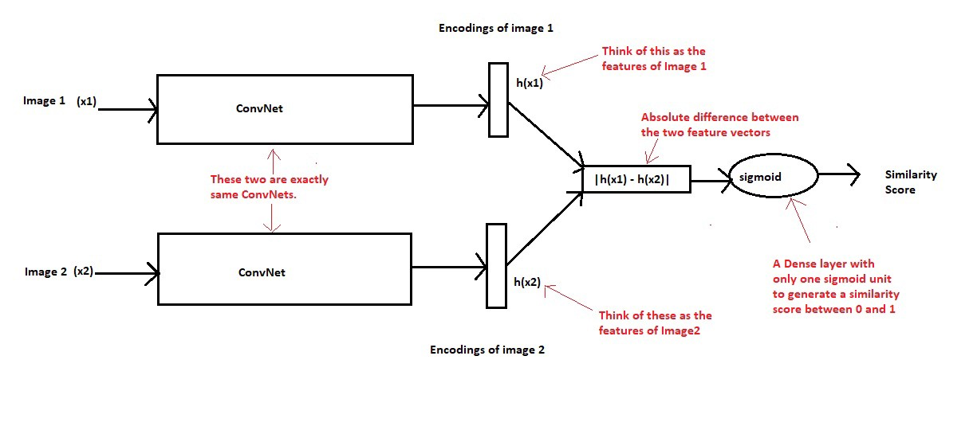
Experiment - Training
Notes:
Change to my data set representation

Slide 16
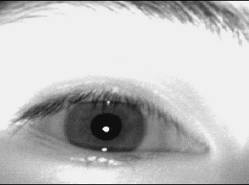
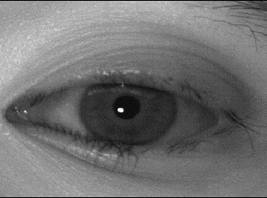
Experiment - Testing
Model output is Similarity score.
But how to judge on similarity score?
We need a better representative metric e.g. accuracy
Img-1
Img-2
Similarity %
80%
Correct prediction
Pair with the highest similarity score = 1
Other pairs = 0
If the prediction is correct:
50%
if pred == label:
correct += 1
accuracy =
correct / count
35%
68%
Testing Sample (4-Ways)
Notes:
Change to my data set representation

Slide 17
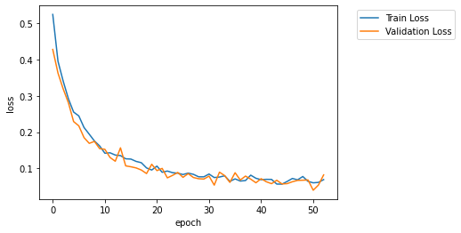
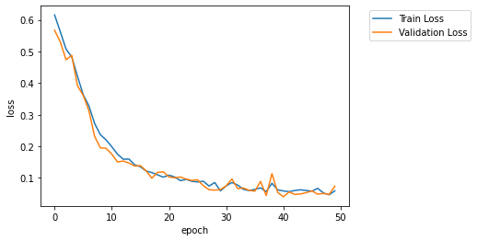
Results – CNN Vs CNN
Net(
(conv1): Conv2d(1, 64, kernel_size=(10, 10), stride=(1, 1))
(conv2): Conv2d(64, 128, kernel_size=(7, 7), stride=(1, 1))
(conv3): Conv2d(128, 128, kernel_size=(4, 4), stride=(1, 1))
(conv4): Conv2d(128, 256, kernel_size=(4, 4), stride=(1, 1))
(bn1): BatchNorm2d
(bn2): BatchNorm2d
(bn3): BatchNorm2d
(bn4): BatchNorm2d
(fc1):Linear(in_features=9216,out_features=4096, bias=True)
(fcOut):Linear(in_features=4096,out_features=1, bias=True)
(sigmoid): Sigmoid()
)
Net_1
Similar to Net_1 but with one
additional fully connected layer:
....
(fc2):Linear(in_features=4096,out_features=512, bias=True)
(fcOut):Linear(in_features=512,out_features=1, bias=True)
(sigmoid): Sigmoid()
)
Net_2

Slide 18
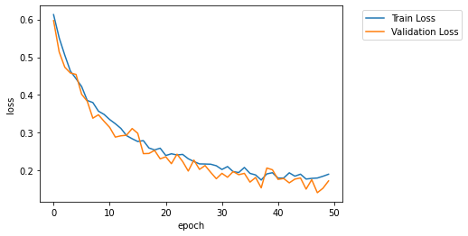
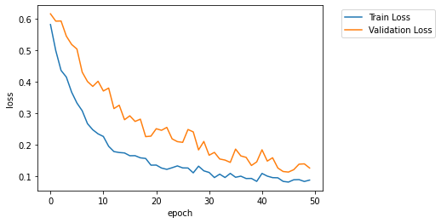
Results – CNN Vs CNN
Net_3
The network has more parameters to fit
Result: Unstable converging. Takes more time and epoch to reach a minima
Similar to Net_1 but with 2 additional fully connected layers
(fc1): Linear(in_features=9216, out_features=4096, bias=True)
(fc2): Linear(in_features=4096, out_features=2048, bias=True)
(fc3): Linear(in_features=2048, out_features=512, bias=True)
(fcOut): Linear(in_features=512, out_features=1, bias=True)
(sigmoid): Sigmoid()
Net_4
Validation loss > Train loss
Overfitting, due to the higher no of layers
Similar to Net_1 but with 1 additional fully connected layers
And one additional convolutional layer
(conv5): Conv2d(256, 256, kernel_size=(3, 3), stride=(1, 1))
(fc1): Linear(in_features=4096, out_features=4096, bias=True)
(fc2): Linear(in_features=4096, out_features=512, bias=True)
(fcOut): Linear(in_features=512, out_features=1, bias=True)

Slide 19
Results
Network/accuracy | 2-way learning | 4-ways learning | 8-ways learning | 16-ways learning
Net_1 | 91,5% | 79,2% | 69,8% | 60,2%
Net_2 | 88,9% | 79,3% | 66,7% | 55,7%
Net_3 | 81,2% | 63,8% | 44,7% | 36,4%
Net_4 | 86,1% | 73,9% | 59,8% | 51,7%
Net_5 | 89,7% | 78,9% | 68,2% | 54,4%
Net_6 | 87,5% | 73,4% | 58,6% | 45%
MLP_1 (with BN) | 84,5% | 71,9% | 59,1% | 46,3%
MLP_2 (with BN) | 79,7% | 60,8% | 44,8% | 35,5%
MLP_3 (without BN) | 33,2% | 13,6% | 8,2% | 3,13%
MLP_3 (with BN) | 84,6% | 69,2% | 55,8% | 40,8%
VGG16 (modified) | 84,5% | 69,1% | 54,5% | 44%
MLP networks were trained for 100 Epochs!!

Slide 20
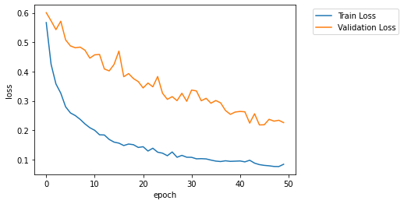
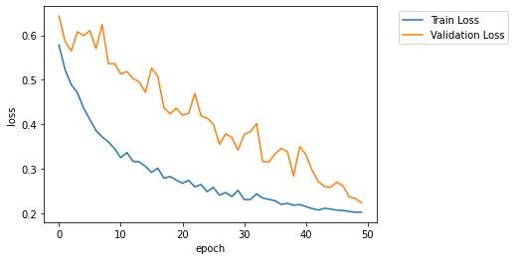
Results – CNN Vs CNN
However relatively good accuracy
Less neurons in the three Fully connected layers
Less parameters
Target is more complex
To achieve with so
Little parameters
Net_5
Important: Balance of network’s complexity and no. of parameters must be achieved
Net_6
Has only 3 convolutional layers
Less layers, but still
20 million more parameter than Net_1
Shows Overfitting, Needs more regularizing

Slide 21
Results
Network/accuracy | 2-way learning | 4-ways learning | 8-ways learning | 16-ways learning
Net_1 | 91,5% | 79,2% | 69,8% | 60,2%
Net_2 | 88,9% | 79,3% | 66,7% | 55,7%
Net_3 | 81,2% | 63,8% | 44,7% | 36,4%
Net_4 | 86,1% | 73,9% | 59,8% | 51,7%
Net_5 | 89,7% | 78,9% | 68,2% | 54,4%
Net_6 | 87,5% | 73,4% | 58,6% | 45%
MLP_1 (with BN) | 84,5% | 71,9% | 59,1% | 46,3%
MLP_2 (with BN) | 79,7% | 60,8% | 44,8% | 35,5%
MLP_3 (without BN) | 33,2% | 13,6% | 8,2% | 3,13%
MLP_3 (with BN) | 84,6% | 69,2% | 55,8% | 40,8%
VGG16 (modified) | 84,5% | 69,1% | 54,5% | 44%
MLP networks were trained for 100 Epochs!!

Slide 22
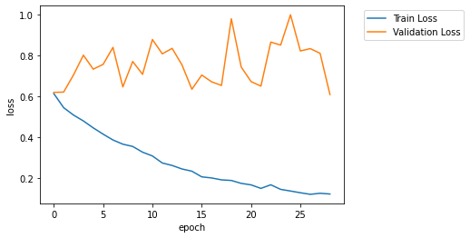
Results – CNN Vs CNN
Net_4
(with dropout layers)
2 layers of dropout were added
Adding more and using other regularization technique could have improved the results even further
Net_4
(without dropout)

Slide 23
Results – CNN Vs CNN
Net_2
Without batch normalization
No significant effect
Net_2
with batch normalization

Slide 24
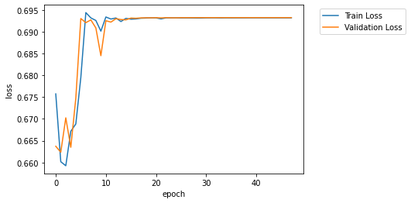
Results – CNN Vs CNN
Net_3
with batch normalization
Unlike Net_2
Adding more FC layers to the network could destabilize it
Net_3
without batch normalization
Exploding gradients;
Not learning

Slide 25
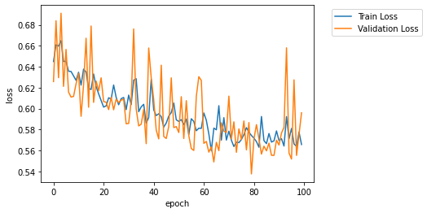
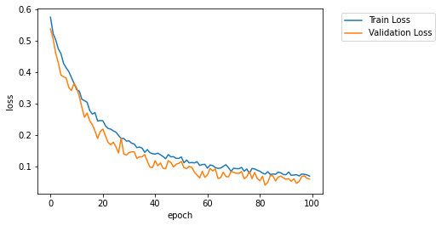
Results – MLP Vs MLP
MLP Net-1
(without batch normalization)
Net(
(fc1): Linear(in_features=11025, out_features=4096, bias=True)
(fc2): Linear(in_features=4096, out_features=2056, bias=True)
(fc3): Linear(in_features=2056, out_features=1028, bias=True)
(fcOut): Linear(in_features=1028, out_features=1, bias=True)
(sigmoid): Sigmoid()
)
MLP Net-1
(with batch normalization)
Batch normalization stabilizes the multi-layer perceptron siamese network

Slide 26
Results
Network/accuracy | 2-way learning | 4-ways learning | 8-ways learning | 16-ways learning
Net_1 | 91,5% | 79,2% | 69,8% | 60,2%
Net_2 | 88,9% | 79,3% | 66,7% | 55,7%
Net_3 | 81,2% | 63,8% | 44,7% | 36,4%
Net_4 | 86,1% | 73,9% | 59,8% | 51,7%
Net_5 | 89,7% | 78,9% | 68,2% | 54,4%
Net_6 | 87,5% | 73,4% | 58,6% | 45%
MLP_1 (without BN) | 71,8% | 46,5% | 30,1% | 18,7%
MLP_1 (with BN) | 84,5% | 71,9% | 59,1% | 46,3%
MLP_2 (with BN) | 79,7% | 60,8% | 44,8% | 35,5%
MLP_3 (without BN) | 33,2% | 13,6% | 8,2% | 3,13%
MLP_3 (with BN) | 84,6% | 69,2% | 55,8% | 40,8%
VGG16 (modified) | 84,5% | 69,1% | 54,5% | 44%
MLP networks were trained for 100 Epochs!!

Slide 27
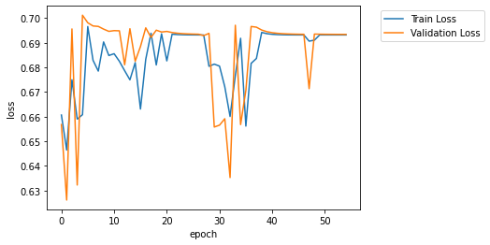
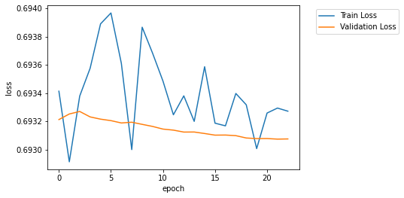
Results – MLP Vs MLP
MLP Net-2
(without batch normalization
Without dropout )
Similar to MLP Net_1 but with 1 additional fully connected layers
(fc4): Linear(in_features=1028, out_features=512, bias=True)
(fcOut): Linear(in_features=512, out_features=1, bias=True)
(sigmoid): Sigmoid()
)
Not learning;
Bad accuracy
MLP Net-3
(without batch normalization)

Slide 28
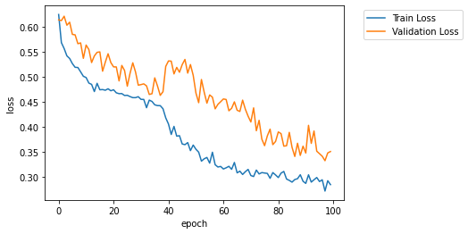
Results – MLP Vs MLP
MLP Net_3
With bn and with dropout
(fc1): Linear(in_features=11025, out_features=4096, bias=True)
(fc2): Linear(in_features=4096, out_features=2056, bias=True)
(fc3): Linear(in_features=2056, out_features=1028, bias=True)
(fc4): Linear(in_features=1028, out_features=512, bias=True)
(fc5): Linear(in_features=512, out_features=128, bias=True)
Net_3
Without bn
- Batch normalization stabilizes the multi-layer perceptron Siamese network
- Dropout prevents overfitting

Slide 29
Results
Network/accuracy | 2-way learning | 4-ways learning | 8-ways learning | 16-ways learning
Net_1 | 91,5% | 79,2% | 69,8% | 60,2%
Net_2 | 88,9% | 79,3% | 66,7% | 55,7%
Net_3 | 81,2% | 63,8% | 44,7% | 36,4%
Net_4 | 86,1% | 73,9% | 59,8% | 51,7%
Net_5 | 89,7% | 78,9% | 68,2% | 54,4%
Net_6 | 87,5% | 73,4% | 58,6% | 45%
MLP_1 (without BN) | 71,8% | 46,5% | 30,1% | 18,7%
MLP_1 (with BN) | 84,5% | 71,9% | 59,1% | 46,3%
MLP_2 (with BN) | 79,7% | 60,8% | 44,8% | 35,5%
MLP_3 (without BN) | 33,2% | 13,6% | 8,2% | 3,13%
MLP_3 (with BN) | 84,6% | 69,2% | 55,8% | 40,8%
VGG16 (modified) | 84,5% | 69,1% | 54,5% | 44%
MLP networks were trained for 100 Epochs!!

Slide 30
Results
Network/accuracy | 2-way learning | 4-ways learning | 8-ways learning | 16-ways learning
Net_1 | 91,5% | 79,2% | 69,8% | 60,2%
Net_2 | 88,9% | 79,3% | 66,7% | 55,7%
Net_3 | 81,2% | 63,8% | 44,7% | 36,4%
Net_4 | 86,1% | 73,9% | 59,8% | 51,7%
Net_5 | 89,7% | 78,9% | 68,2% | 54,4%
Net_6 | 87,5% | 73,4% | 58,6% | 45%
MLP_1 (without BN) | 71,8% | 46,5% | 30,1% | 18,7%
MLP_1 (with BN) | 84,5% | 71,9% | 59,1% | 46,3%
MLP_2 (with BN) | 79,7% | 60,8% | 44,8% | 35,5%
MLP_3 (without BN) | 33,2% | 13,6% | 8,2% | 3,13%
MLP_3 (with BN) | 84,6% | 69,2% | 55,8% | 40,8%
VGG16 (modified) | 84,5% | 69,1% | 54,5% | 44%
MLP networks were trained for 100 Epochs!!

Slide 31
Results – Ubiris II dataset
Testing the previous models on Ubiris II dataset.
Produced a similar pattern of the accuracy results we got from MMUII dataset

Slide 32
Improvements?
Dataset Preprocessing : normalizing, Iris position localizing, reduce dataset noise, etc ..
Training for more Epochs
Larger images (better resolution) for training.
Applying regularizing techniques to the CNN networks.
Using other loss functions (contrastive loss, ..).
Using other metrics for similarity measurments (cosine, ..).
Utilizing benchmarks CNN networks and comparing their performance (alexnet, resnet50, ..).
More attention for the receptive field effect.

Slide 33
Thanks for your attention ☺

